Slide 1

K.L.E SOCIETY'S
C B KORE POLYTECHNIC, CHIKODI
KARNATAKA 2022-23
DEPARTMENT OF COMPUTER SCIENCE & ENGINEERING
A PRESENTATION REPORT ON
“DISEASE PREDICTION AND DOCTOR RECOMMENDATION”
UNDER THE GUIDENCE OF
Miss. SARITA KHOT(LECTURER)
A
Presentation
Submitted By:-
Palak Jain {339CS20014} Puneet Pammannavar {339CS20019}
Shivtej Ghorpade {339CS20024}
Shreyas Kumbar {339CS20025}

Slide 2
Disease Prediction And Doctor Recommendation

Slide 3
INDEX
Introduction
Abstract
Literature survey
Requirements
Advantages
Data flow Diagram
Use Case Diagram
Methodology Used
Implementation
Future Scope
Project Screenshot
Conclusion
References and Bibliography

Slide 4
INTRODUCTION
The Disease Prediction and Doctor Recommendation (DPDR) is a medical application that aids patients in predicting diseases and suggesting doctors.
This Website has been developed with the purpose of providing assistance to patients in selecting the right doctor for the successful prediction of various illnesses. The Website also provides information about the doctor such as their credentials, experience etc.
This serves as a valuable resource for patients seeking additional information.
This information can help the user make an informed decision regarding which doctor to contact. By understanding the details provided, the user can decide on the most appropriate doctor to address their specific needs

Slide 5
ABSTRACT
The purpose of this project is to create an online illness prediction and recommendation platform. In this initiative, doctors must register before clients may visit this site, where the technology predicts the condition and provides treatment options. Based on their symptoms, recommends available physicians. The customer will be able to find the best doctor for his needs. To achieve this project, we will utilize full stack development languages such as HTML, CSS, PHP, JavaScript, Bootstrap, and MySQL DB.

Slide 6
LITERATURE SURVEY
Existing system:- According to a poll of existing patients, users must visit a hospital to get their disease examined. As a result, there is no such mechanism to anticipate the sickness of the patients.
Proposed System:- We will create this illness prediction and medical advice. This project aims to create an online Disease Prediction and Doctor Recommendation system. Users may access this portal to have their symptoms predicted, but doctors must register for it. The system will then make a recommendation for the finest physician via this portal at that time. The user will discover the ideal medical professional for his condition. We will use full stack development languages including PHP, JavaScript, Bootstrap, MySQL DB, HTML, and CSS to accomplish this project.

Slide 7
REQUIREMENTS
Requirements for developing:-
Hardware requirement for deployment:-
Average I3 processor.
Average 4GB RAM.
Average 512GB hard disk
Average I3 processor.
Average 2GB RAM.
Average 256GB storage.
Software requirement for development:-
Language used or technology:-
OS (Window’s , MAC , Linux).
XAMP Server.
VS Code.
Chrome.
Content Language (Client Side Language) (HTML, CSS, BOOTSTRAP, JS).
Backend (server side language) (PHP).
Database (My SQL).
Software requirement for deployment:-
• OS.
• Chrome.

Slide 8
ADVANTAGES
Information about diseases is available to users anytime and everywhere.
Cut down on user time.
Easy illness prediction will be possible for the user.
Based on their disease, users may quickly identify qualified doctors.

Slide 9
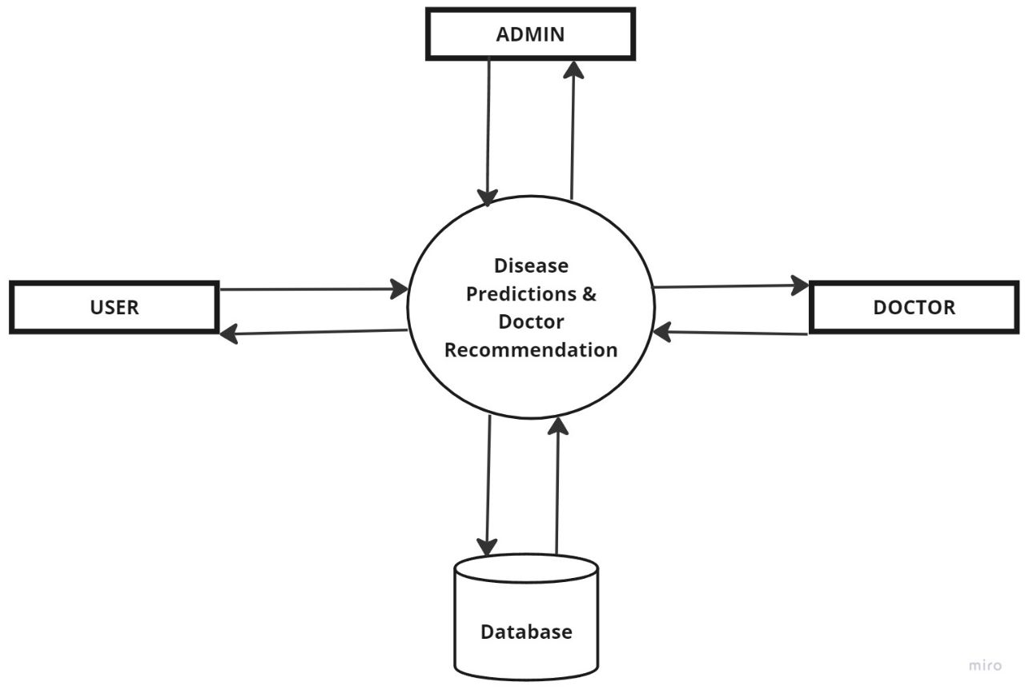
DATA FLOW DIAGRAM
Level 0 :-

Slide 10
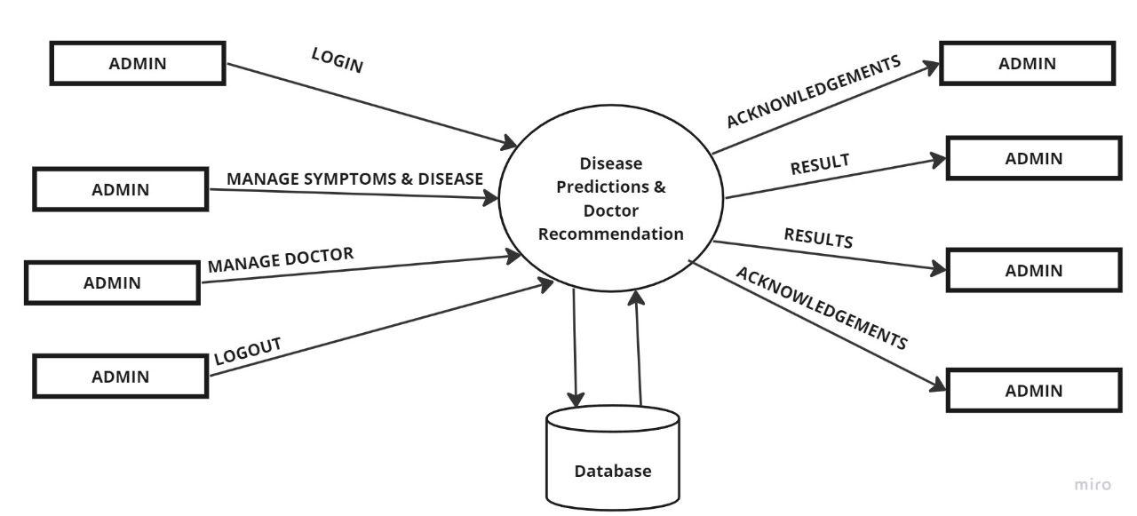
DATA FLOW DIAGRAM
Level 1 :- ADMIN

Slide 11
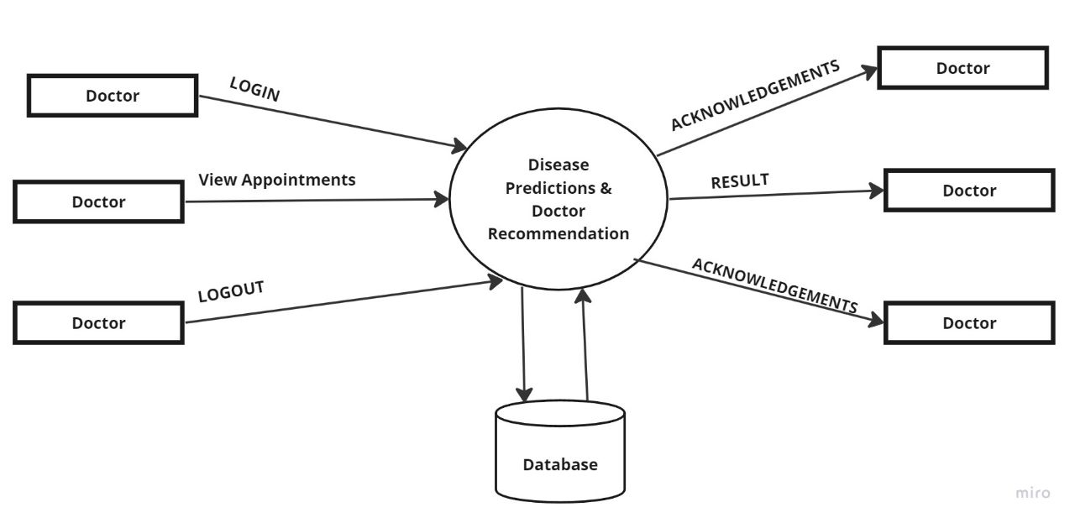
DATA FLOW DIAGRAM
Level 1:- Doctor

Slide 12
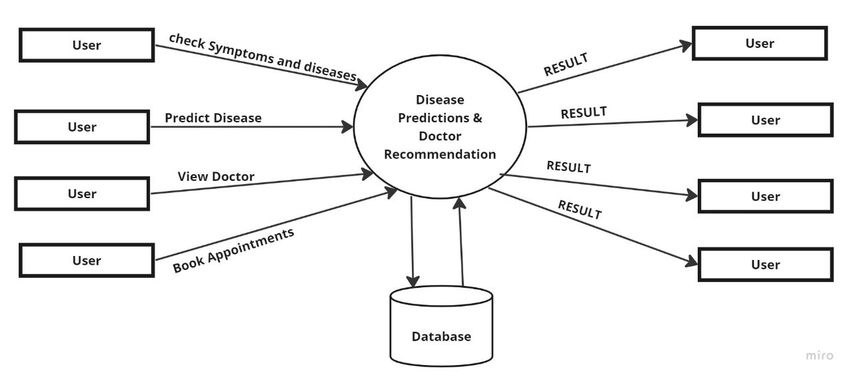
DATA FLOW DIAGRAM
Level 1 :- USER

Slide 13
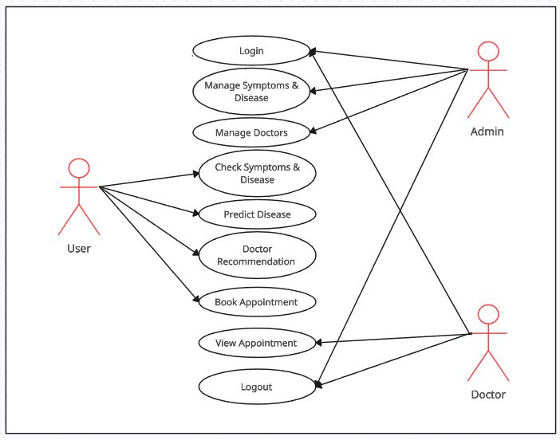
USE CASE DIAGRAM

Slide 14
METHODOLOGY USED
Agile Methodology is a process for managing a project that involves constant collaboration & working in iteration.
Agile project Management work off the basis that a project can be continuously improved upon thought its life cycle, with changes being made quickly & responsibility.
Phases Of Agile Model:-
Requirement Gathering.
Design the requirement.
Construction/Iterations.
Testing/Quality Assurances.
Deployment.
Feedback.

Slide 15
IMPLEMENTATION
Admin Login: Using user name and password admin can login to this project.
Manage symptoms & Diseases: Admin will manage the symptoms & Disease
Manage Doctor: Admin will accept the Hospitals registration
Doctor Login: Using username & Password Doctor will Login to this System.
View Appointments: The appointments that are scheduled for the day will be visible to the doctor.
Check Symptoms & Disease: In this module user can view the Disease.
Predict Disease: In this module user can be able to predict Disease.
View Doctors: In this module user can view the Doctors based on their Disease.
Book appointment: This module will allow users to schedule appointments with the doctors of their choice.

Slide 16
FUTURE SCOPE
In the future, it is possible to develop the existing concept into a mobile application.
The project that we're working on can be implemented in any location.

Slide 17
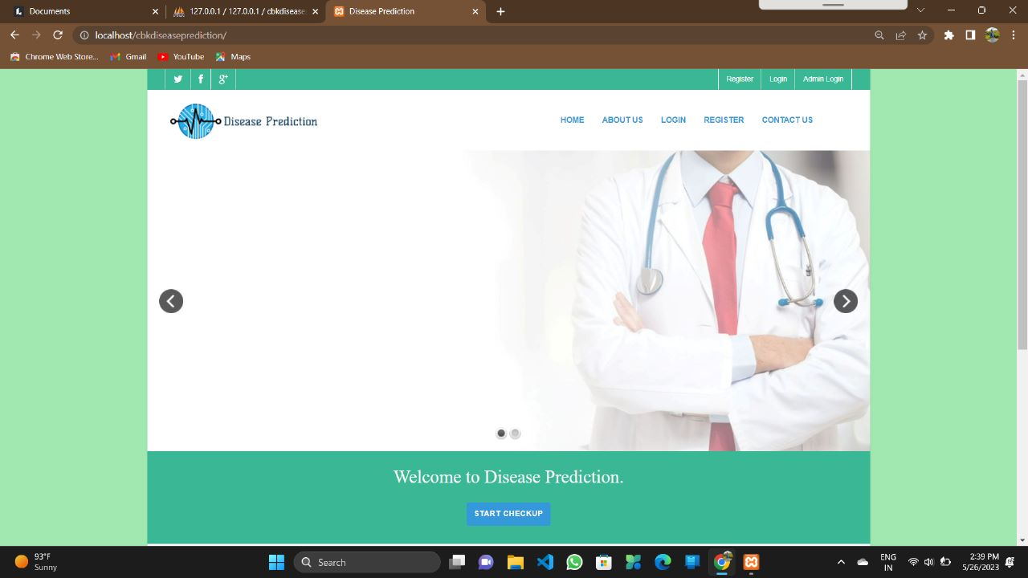
Home Page

Slide 18
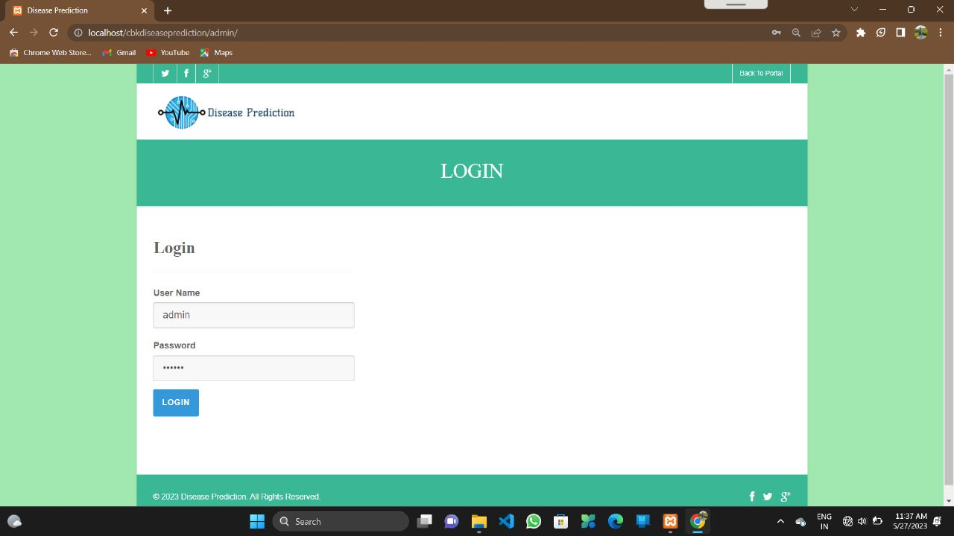
Admin Login

Slide 19
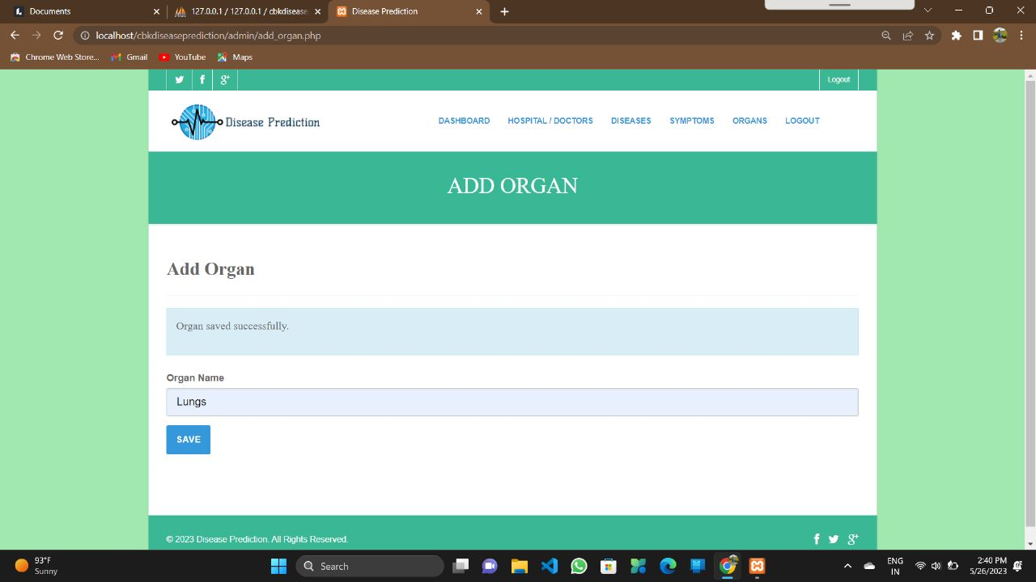
Add Organ

Slide 20

Add Symptoms

Slide 21
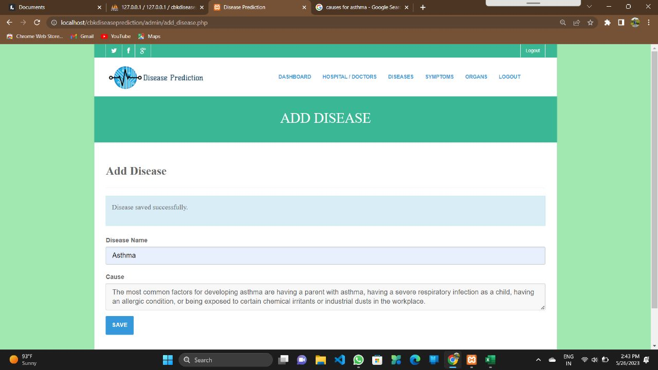
Add Disease

Slide 22
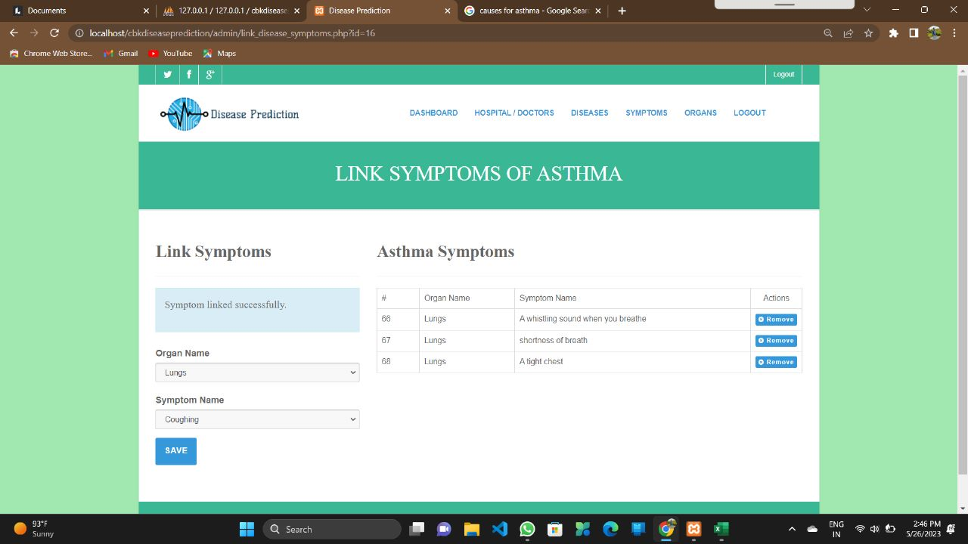
Link Symptoms & Disease

Slide 23
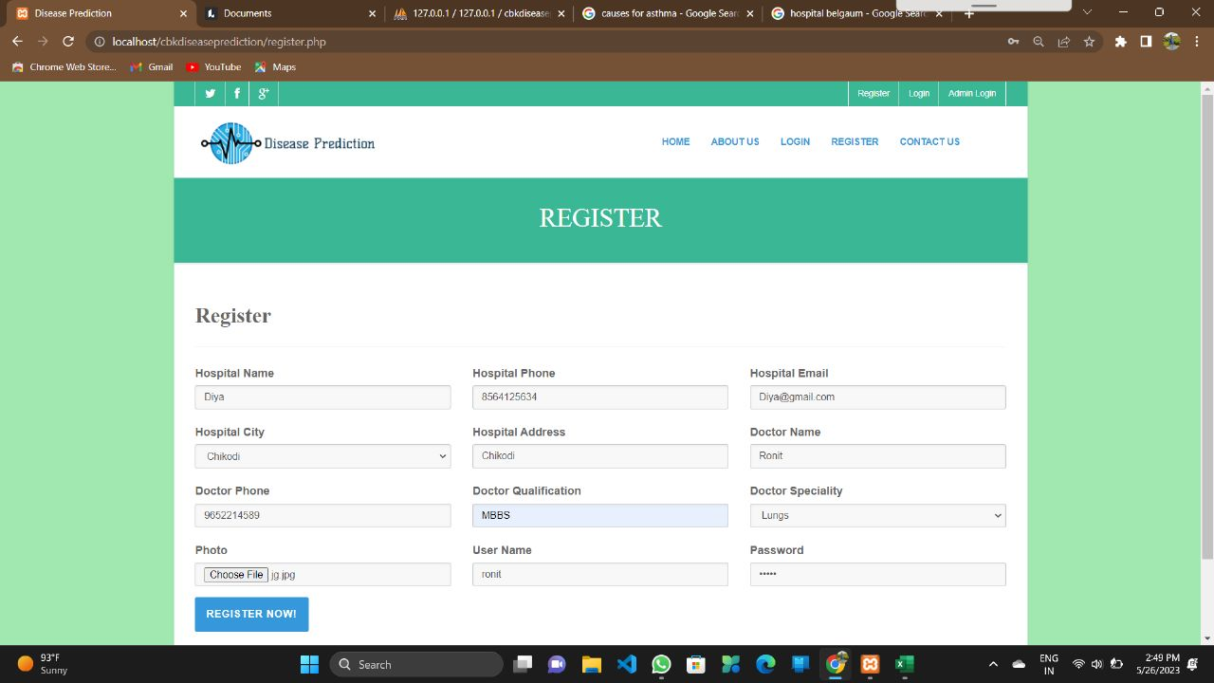
Hospital Registration

Slide 24
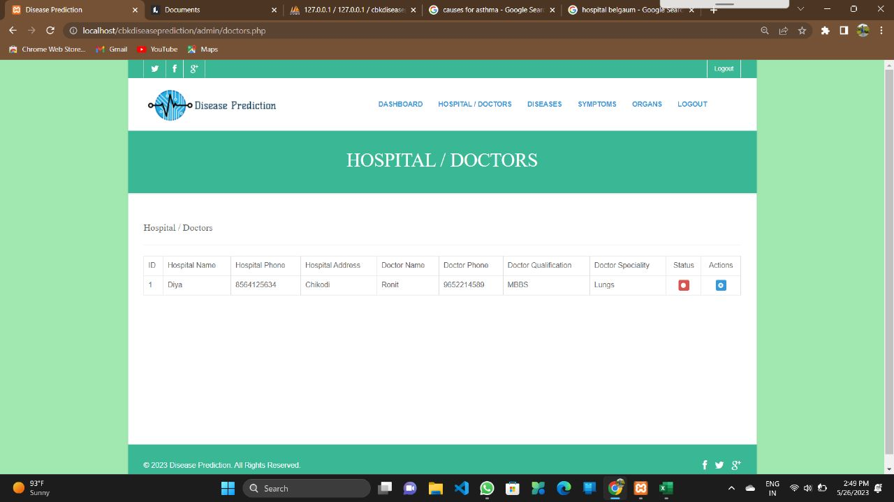
Accepting Request of Hospital

Slide 25
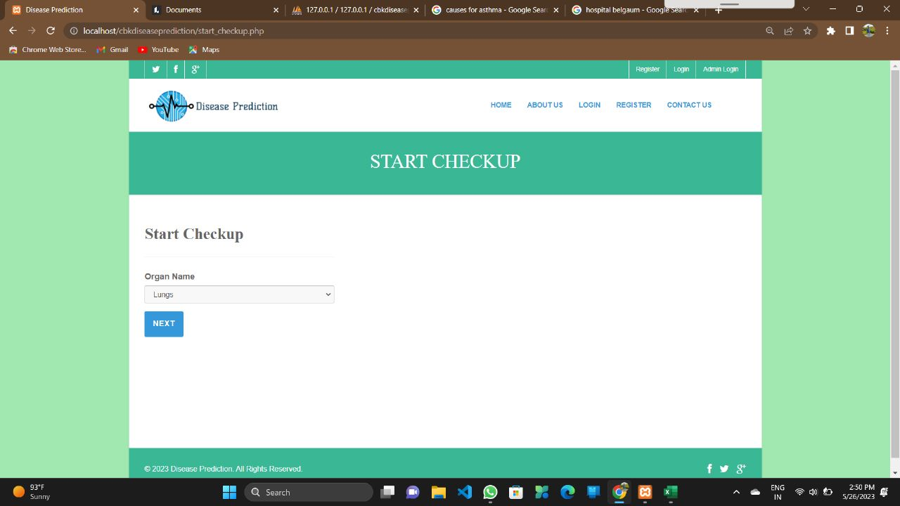
Select Organs

Slide 26
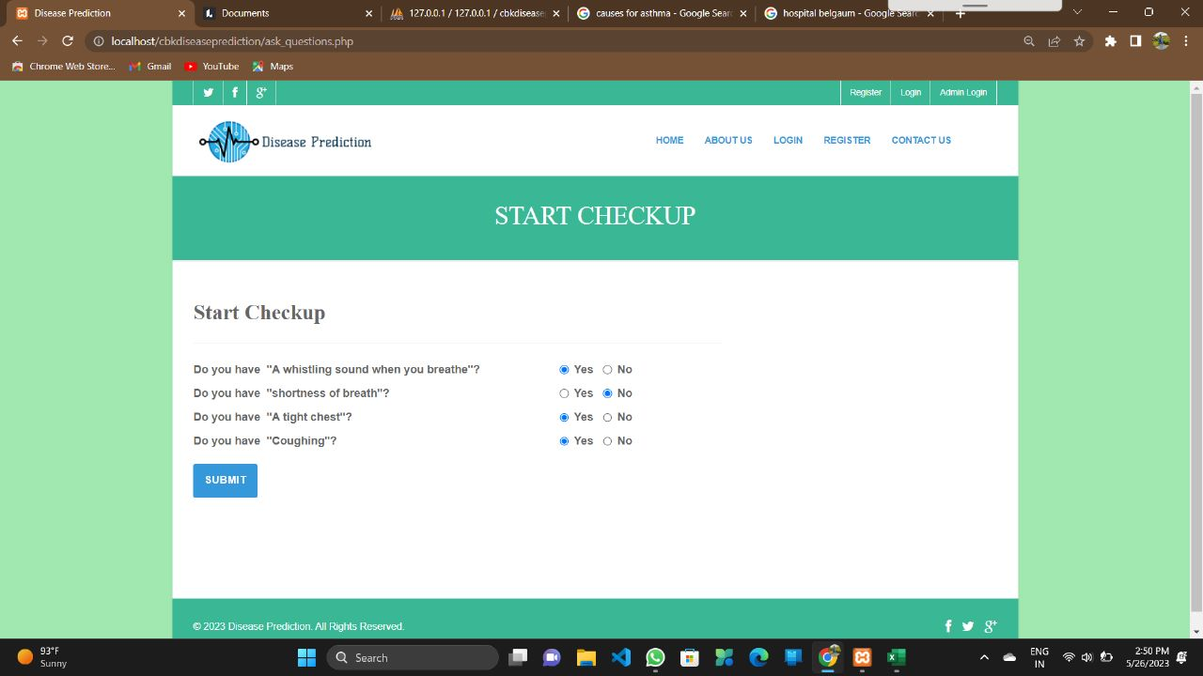
Check Symptoms

Slide 27
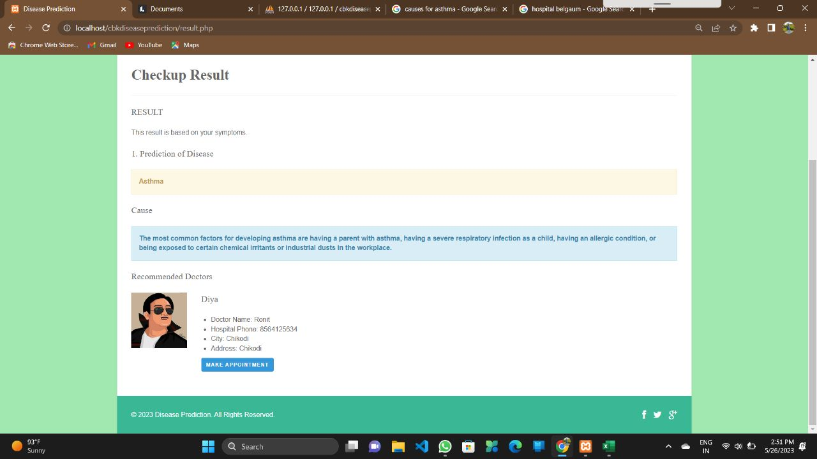
Predicting Disease

Slide 28
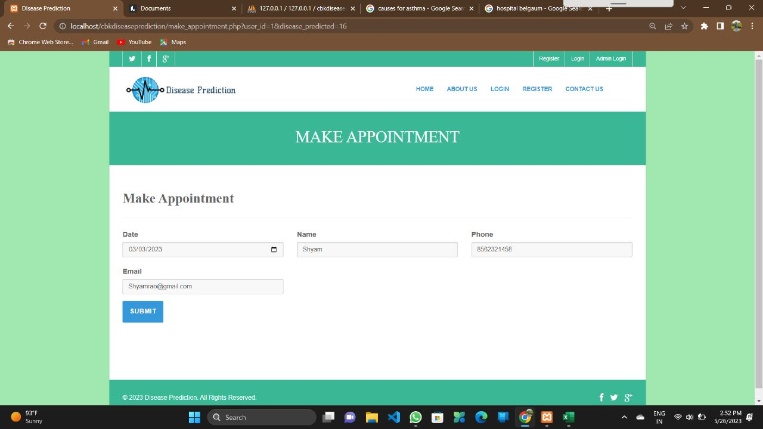
Book Appointment

Slide 29
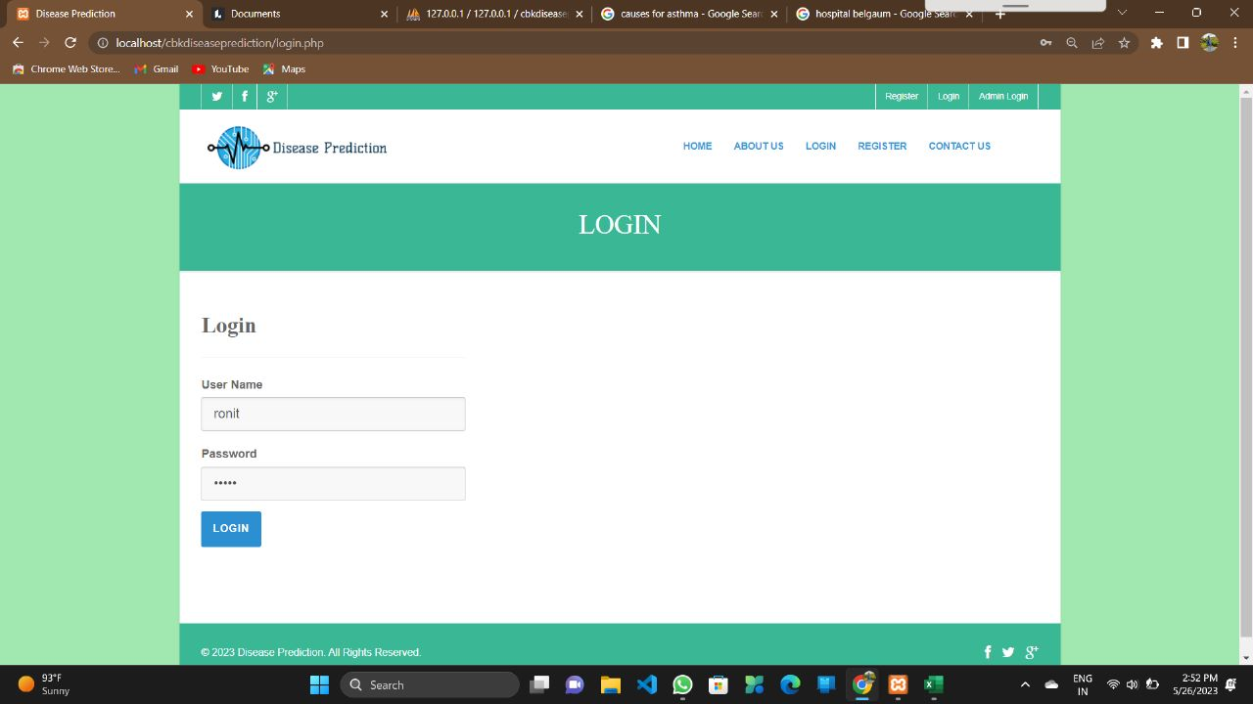
Doctor Login

Slide 30
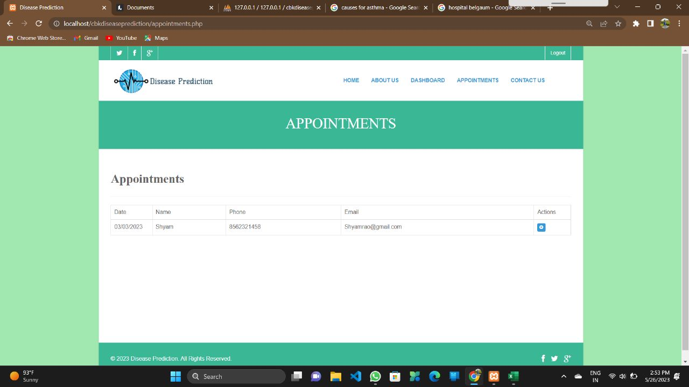
View Appointments

Slide 31
CONCLUSION
Our competent and experienced staff will design and build a website that fully corresponds to all pre-established system criteria. The website will offer a number of carefully built components, such as an advanced disease prediction module, extensive user management capabilities and highly effective doctor management features. Visitors to the site will be able to accurately assess their overall health status by utilizing the advanced capabilities of the disease prediction module, while also receiving personalized recommendations on appropriate disease management strategies and being connected with best-fit specialist doctors for their individual needs.

Slide 32
References and Bibliography
Books: -
[1] “Web Programming”, by ‘Chris Bates’ Wiley Dreamtech India, 2nd Edition.
[2] “Software Engineering”, Ian Somerville, Sixth Edition, Pearson Education Ltd.
[3] “HTML Complete References” Easy steps to develop web pages.
[4] “PHP Complete Reference”
Websites: -
[1] http://en.wikipedia.org/wiki/PHP for Php.
[2] http://www.hotscripts.com/category/php/ for Php
[3] http://www.mysql.com/click.php?e=35050 for MySQL.
[4] http://www.w3schools.com for information on HTML.

Slide 33
Thank you

